Slide 1
Machine Learning

Slide 2
Machine Learning
It is the field of study that provides computers the capability to learn without being explicitly programmed.

Slide 3
Machine Learning
Data (Input)
AI
Traditional Programming
Program
Output
ML
DL
Data (Input)
Machine Learning
Output
program

Slide 4
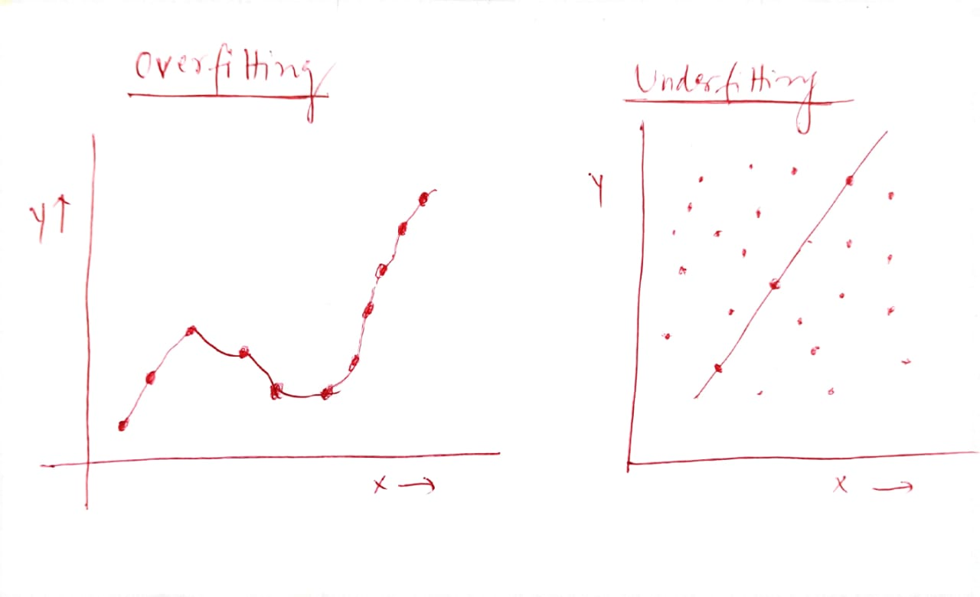
Overfitting and Underfitting

Slide 5
Example:
Result : Ball
Result : Ball
Criteria: Sphere
Orange
Criteria: Sphere
: Play
: Not to eat
: radius : 5 cm

Slide 6
Decision Tree
Decision trees used in data mining are of two main types:
Classification tree: analysis is when the predicted outcome is the class (discrete) to which the data belongs.
Regression tree: analysis is when the predicted outcome can be considered a real number (e.g. the price of a house, or a patient's length of stay in a hospital).

Slide 7
Decision Tree
A classifier (Tree Structure)
Decision Node (Test)
Leaf Node (Classification value)
Also used for Regression
Test is performed on the features /attributes
Employed
No
Yes
Credit Score
Income
High
Low
Low
High
A
R
R
A

Slide 8
Thank You

